Slide 1
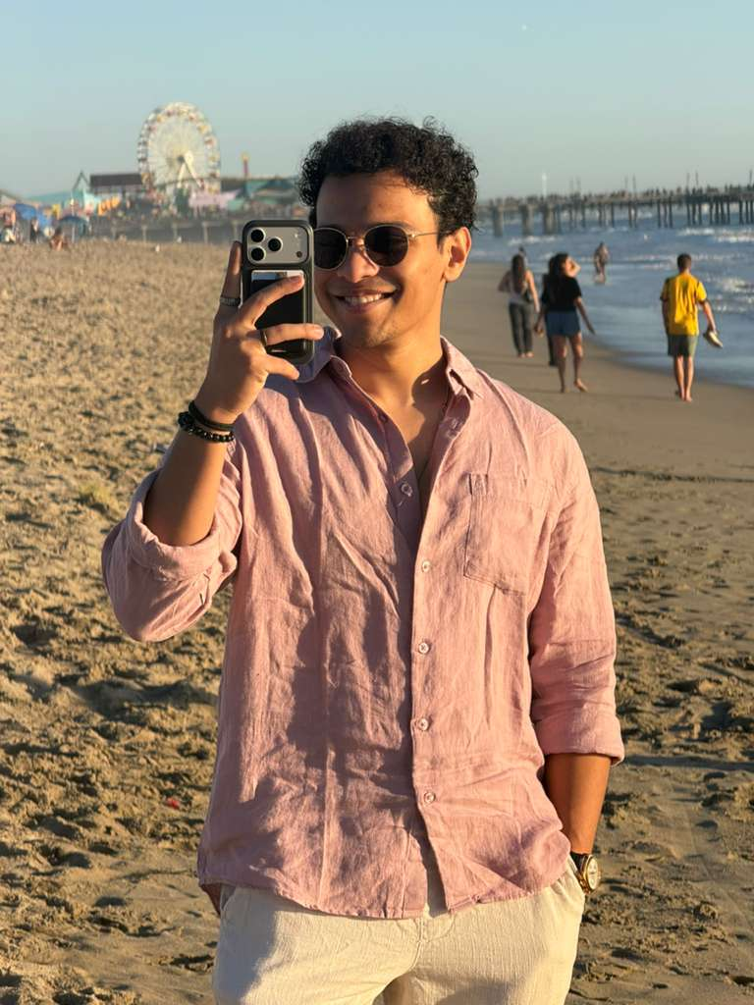
Hello, my name is Pratyay Dutta
University: UC Riverside
Favorite Course: Advanced Computer Vision
Hometown: Kolkata, India
Hobbies: Sketching, Reading (fiction), soccer, badminton.
Why you chose DSSI: Love how the best minds of the country aggregate here for communal learning. Also, my mentor’s work attracted me a lot.

